Slide 1
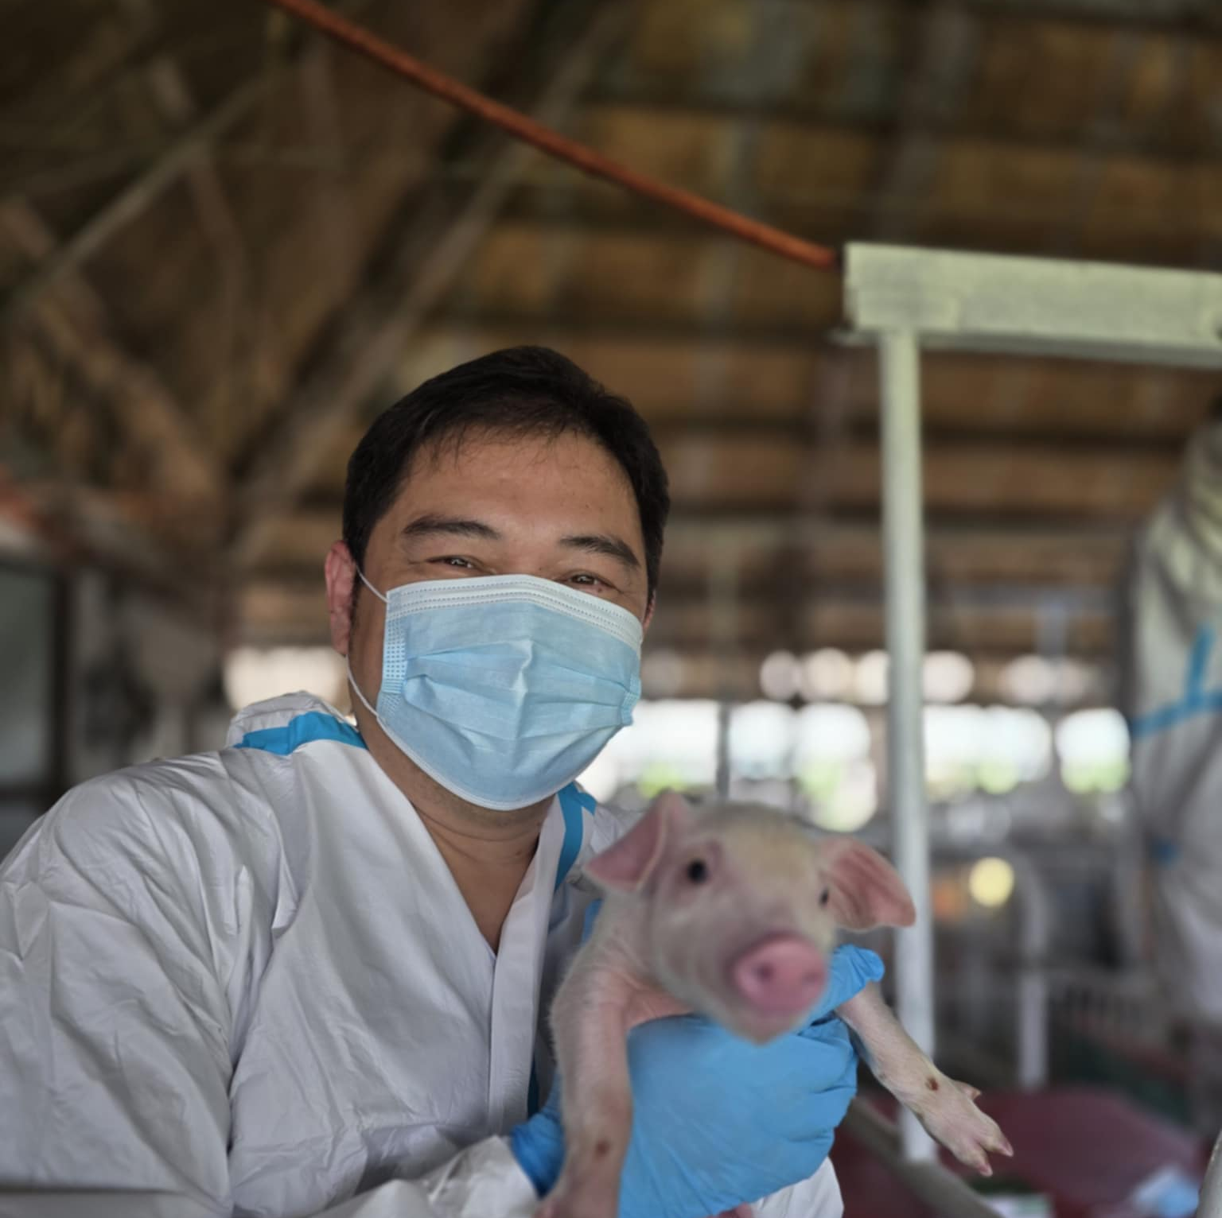
Lessons Learned from Evaluating Biosecurity Practice in Commercial Farms in the Fight against ASF
Marlon L. Linatoc, DVM Dip PCSP
Swine Health and Production Efficiency Consultant

Slide 2
Presentation Flow
Introduction
Biosecurity Against ASF: Why the need to keep talking about it?
Case Studies
Interactions with farms on Biosecurity improvements
Lessons Learned

Slide 3
Introduction

Slide 4
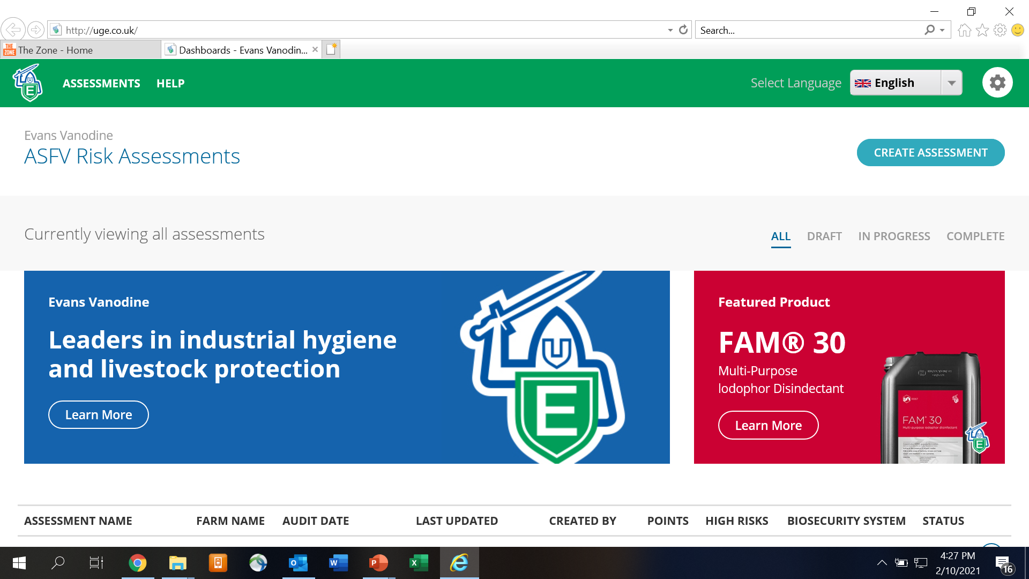
Zoetis Philippines Biosecurity Audit
ASFV RISK ASSESSMENT TOOL
Key Areas:
Pests, Barns and Silos, Manure, Dead Pigs, Visitors, employees, materials, replacement pigs coming into the farm, entrance/shower area, Cleaning, disinfection, Market area, Sick animals
High Risk Areas:
< 1km from other farms
Bringing Food into the farm
Handling of materials into the farm
Disinfection of materials into the farm
Separation of Clean and dirty areas at all entrances
Notes:
The manufacturer of our biosecurity products, Evans, Vanodine UK, developed an Online ASFv Risk Assessment tool through their consultant from Denmark. When ASFv entered the Philippines in the second half of 2019, they launched this to us, Zoetis Philippines, so we can use this tool to help local farms identify the biosecurity weaknesses in their farm that could be an entry route of ASFv.

Slide 5
Zoetis Philippines Biosecurity Audit
 | No of Farms | Total Sows | Ave Sows per Farm | Ave Audit Score | Ave # of High Risks | Biosecurity Level
 |  |  |  |  |  | High | Medium | Low
North Luzon | 82 | 50,595 | 617 | 167 | 4 | 0 | 5 | 77
South Luzon | 63 | 41,540 | 659 | 166 | 5 | 0 | 5 | 58
VisMin | 53 | 37,370 | 750 | 170 | 4 | 2 | 13 | 38
Total | 198 | 129,505 |  | 168 | 4 | 2 | 23 | 174
(passing score >215)
1.4%
11.6%
87%
* Done by Zoetis Philippines Inc in 2019-2020
Notes:
These are the results of all the risk assessments that we have done in 198 farms in the second half of 2019.

Slide 6
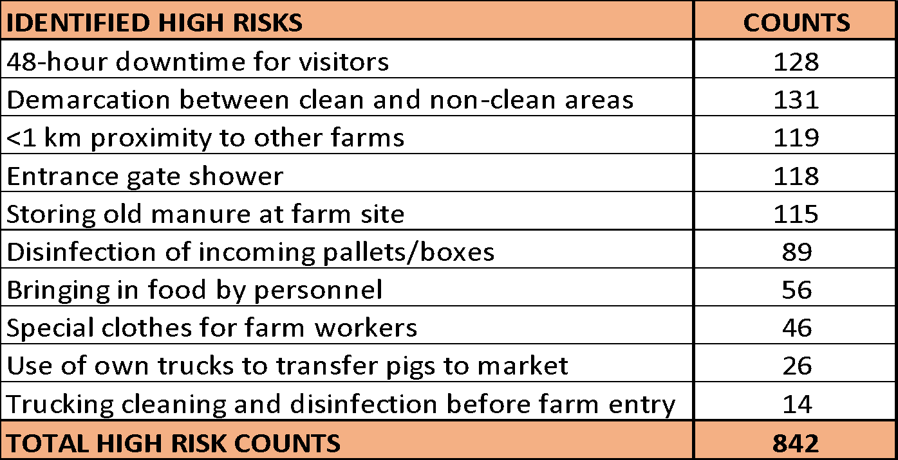
Zoetis Philippines Biosecurity Audit
TOP 10 BIOSECURITY RISKS
2. 128/198 = 64%
1. 131/198 = 66%
3. 119/198 = 60%
4. 118/198 = 60%
5. 115/198 = 58%
6. 89/198 = 45%
7. 56/198 = 28%
8. 46/198 = 23%
9. 26/198 = 13%
10. 14/198 = 7%
* Done by Zoetis Philippines Inc in 2019-2020
Notes:
From the same risk assessment activities, we have identified the most common risks in those 198 farms.

Slide 7
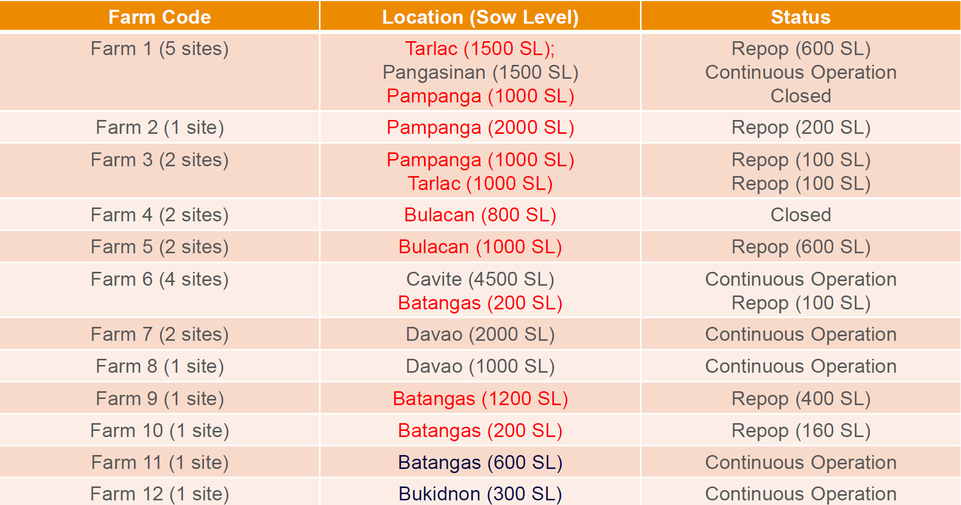

Slide 8

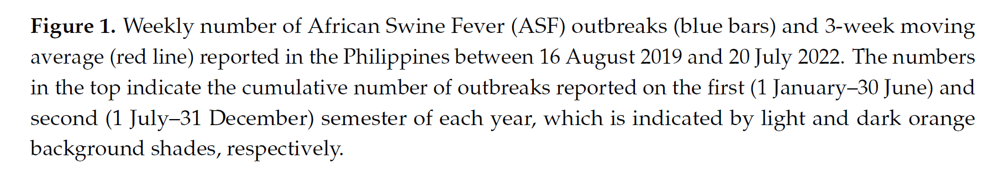
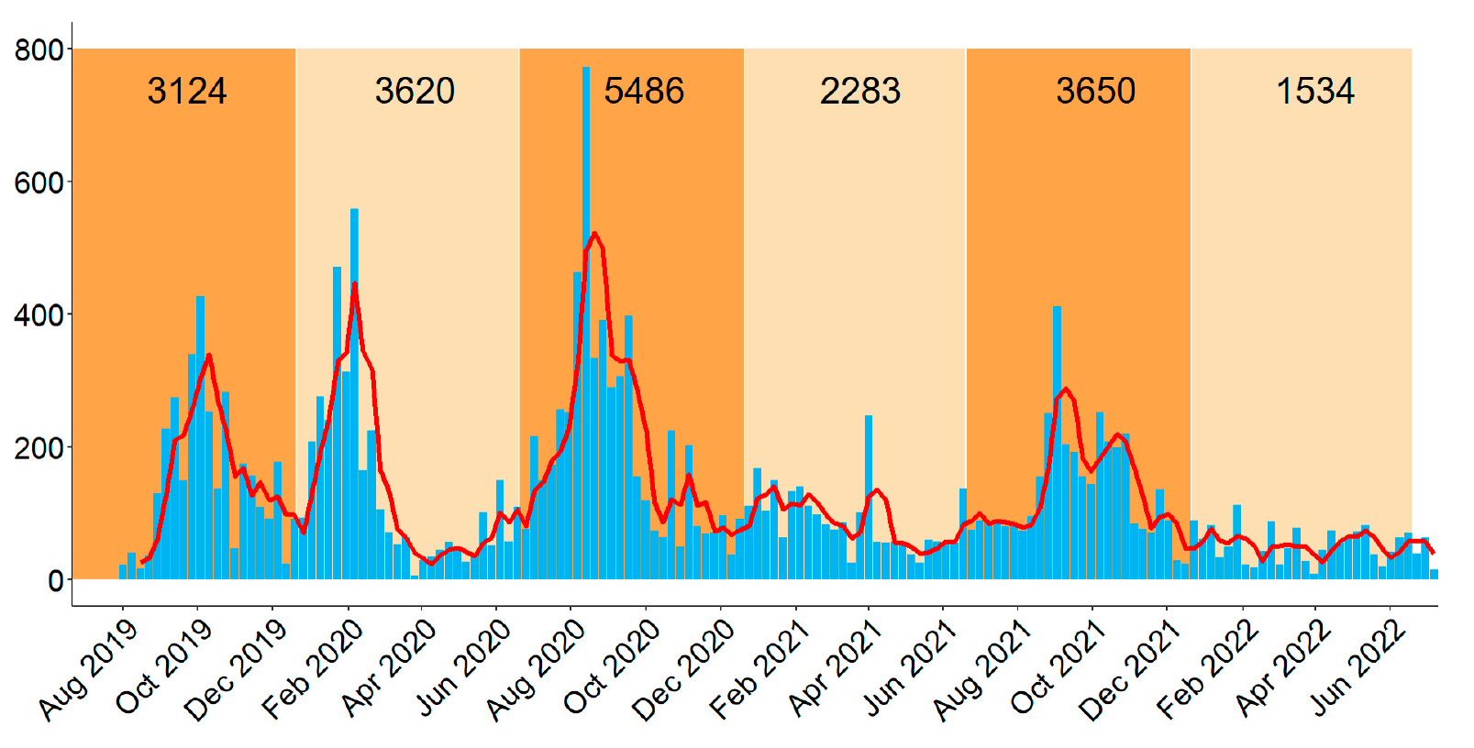
Microorganisms 2023, 11, 1492

Slide 9
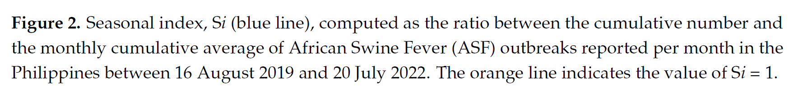
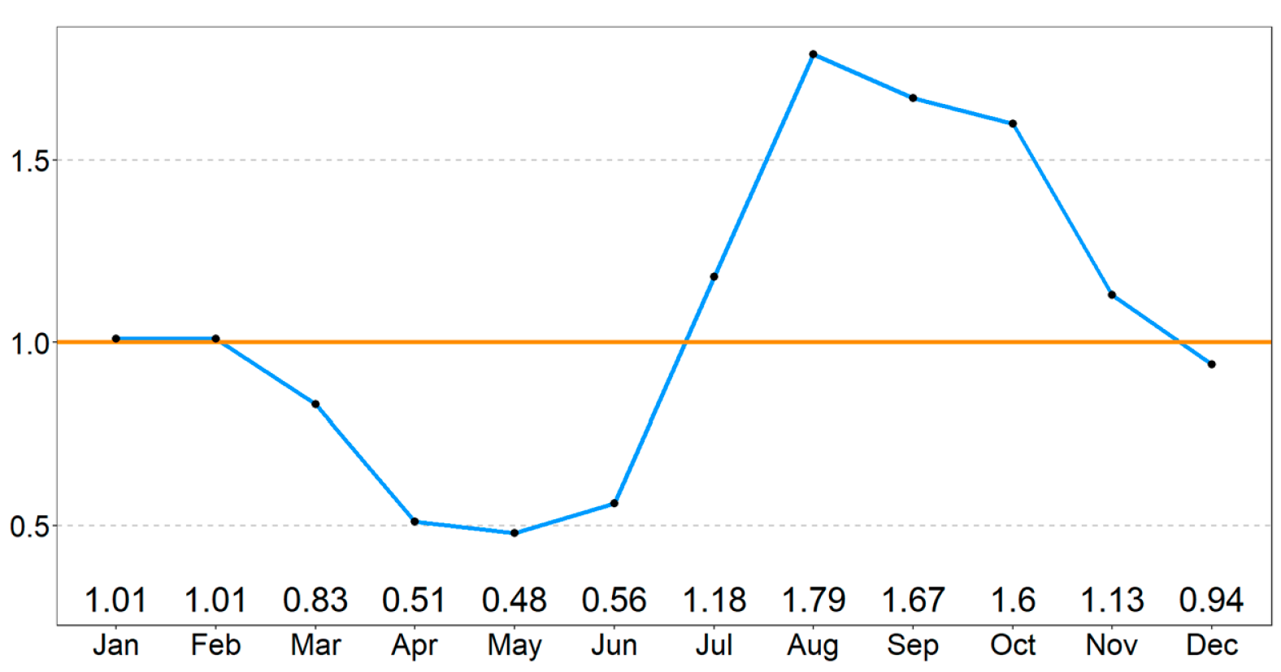
Microorganisms 2023, 11, 1492

Slide 10
Case Studies – Interactions with Farms on Biosecurity Improvement

Slide 11
Case 1: 500 SL Farrow to Finish Farm
Biosecurity in Place
Fully fenced perimeter. Tire vat, Spray Vehicle at entrance
Parking 200m away from the Pig area
Shower, change of clothes, footwear, Required at Gate of Pig Area
Health Status Pre-ASF: Positive but stable for PRRS, Mhyo, APP

Slide 12
Case 1: 500 SL Farrow to Finish Farm
2019
Dec
2019
Dec
2020
Jan 2nd wk
Initial Case
Breeding Bldg. 4, ~30-50d pregnant
Off-feed ~6 sows (AM)(different places in the building),
All aborted late PM with high fever 40.5C,
All died the next 3 days.
Similar cases observed in all other breeding buildings
Similar cases observed in 2/3 Farrowing buildings Farr Bldg2
Sows and litter (~2wks); Farr Bldg3 (Pregnant sows)

Slide 13
Case 1: 500 SL Farrow to Finish Farm
2020
Jan 3rd wk
2020
Feb 1st wk
2020
Jul 1st wk
Signs observed in Nursery Bldg. 3 (4 pens, 20 heads total)
Off feed, pale, severe depression, abnormal breathing. Diarrhea
Owner decided to cull all remaining sows/boars
(all breeding building), All sows + litter in 2 farrowing buildings and 1 row in Nursery building 3
(~200 piglets)
At that time, breeder mortalities was 45 heads, and culled close contact were 75 heads.
All finishers were sold (Breeding, Nursery, Grow out buildings were vacant)
Remaining were 30 sows and some piglets in Farr Bldg1

Slide 14
Case 1: 500 SL Farrow to Finish Farm
REPOP ATTEMPT 1
Only Disinfection and downtime done
Sep 2020 (1st wk)
30 pregnant P0 (93 -100 days pregnant) delivered to Farrowing Building 2
Oct 2020 (1st wk)
30 pregnant P0 (93 -100 days pregnant) delivered to Farrowing Building 3
Nov 2020 (1st wk)
Off feeding in sows, severe depression (including majority of litters) in Farrowing Building 3
Decided to cull all animals in this building

Slide 15
Case 1: 500 SL Farrow to Finish Farm
REPOP ATTEMPT 2
Disinfection and downtime
Bird proofing all farrowing and breeding buildings
Single entrance and exit all buildings
Change of footwear + handwash at entry
Repairs done Nov-Dec-January 2021
NEW

Slide 16
Case 1: 500 SL Farrow to Finish Farm
2021
Feb 1st wk
2021
Mar 1st wk
2021
Apr 1st wk
30 pregnant P0 sows (93 -100d) delivered to Farrow Bldg. 3
Transferred weaned sows to breeding
Delivered 100 gilts to breeding
2021
Jun 4th wk
2021
Jul 2nd wk
2021
Apr 1st wk
Heavy rains led flood waters going into the breeding buildings
Off-feeding + fever: pregnant
Mortalities in gilt pens
Pale, severe depression, scouring, abnormal breathing, high fever
All gilts and sows at Breeding Building 2 were culled.

Slide 17
Case 1: 500 SL Farrow to Finish Farm
REPOP ATTEMPT 3
All walkways were bird proofed (included in the clean area)
Drainage around breeding buildings repaired (no entry of flood waters in pig area)
Shower facility for breeding personnel built
All repairs done August-September-October
NEW
Nov 2021
First weaned sows transferred to Breeding Building 2
Dec 2021
Resumed pregnant sow delivery (40 sows per month)
March 2022
Resumed Replacement Gilt and Junior Boar Delivery
July 2022
406 sow level
No new cases

Slide 18
Case 2: 1,200 SL Farrow to Finish Farm
Biosecurity in Place
Fully Fenced | Shower in, complete change of clothes (including viajeros)
UV Box (gate) all incoming outside supplies | Uses commercial feeds
Separate parking area for visitor cars
Health Status Pre-ASF (Positive stable to PRRS, Mhyo, APP)
Initial Reported Case
Sep 14, 2020: 2 sows aborted, died Sep 15 & 16 (Breeding BldgA1 row 4)
Sep 23, 2020: 3 sows aborted, died Sep 24. 100% Rapid test positive (Breeding BldgA1 row 3)

Slide 19
Case 2: 1,200 SL Farrow to Finish Farm
Sep 25, 2020: Culled 12 pregnant sows (4 sows on each side of the positive sow)
Oct 2020 (1st wk):
Initial cases (off-feeding in Farrowing Rm 1B (4 heads))
Rapid Ag test kit + |Cull all 4 and 8 sows in close contact (one on each side of the sows)
Oct 2020 (2nd wk):
Off feeding reports, high fever (Breeding Building – Old and A1, Farrowing Room 1B)
100% Positive Rapid Ag Test Kit (7 heads) | Culled all 7 and 15 in contact
Oct 2020 (3rd wk)
Gilt and Dry sow buildings affected, culled 20 dry sows and 40 gilts
Boar house affected, culled 12 boars

Slide 20
Case 2: 1,200 SL Farrow to Finish Farm
Oct 2020 (4th wk)
Owner decided to collect blood from ALL remaining sows (~1,100 sows)
Did PCR test on 220 pools (1:5 pooling)
Nov 2020 (1st wk)
PCR Test Results: 4 pools ASF Positive
4 positive pools tested individually: 9 out of 20 samples were POSITIVE
9 out of 1100 sows were positive
Decided to cull all 9 positive sows, and 24 in-contact sow

Slide 21
Case 2: 1,200 SL Farrow to Finish Farm
Nov 2020 (2nd wk)
Another 10 tested positive using Rapid Ag kit,
Culled all 10 and 22 in contact sows
First case in NH Rm 1B in 3 pens
Culled 6 pens (120 piglets 4-5 weeks old)
Dec 2020 – Jan 2021
Cases still reported in sows both from breeding and farrowing
First cases in GF Building (75 120 days old culled)

Slide 22
Case 2: 1,200 SL Farrow to Finish Farm
Feb 2021
Owner decided to drastically reduce sow level to 250
Culled around 600 sows the whole month of February
About 80 remained in the F3 different farrowing buildings
The rest remained in 1 Breeding room
No movement of sows, no vaccination

Slide 23
Case 2: 1,200 SL Farrow to Finish Farm
Repop Strategy Execution (March –July)
Completely cleaned and disinfected all buildings, drainage and surroundings
Implemented segregation of biosecurity zones
Bird proofed all buildings that will be used
Covered all walkways (with roofing, bird proofing)
Installed shower facilities at Breeding, Farrowing, Nursery, Grow-out)
Installed Fumigation boxes (for small items) and rooms (for Feeds) in all sections
Reorganized staff housing per section
All grower pens will be gradually converted to solid partitions

Slide 24
Case 2: 1,200 SL Farrow to Finish Farm
Aug 2021
Started selecting market hogs (145 days old) for gilt conditioning
Movement of sows (Breeding to Farrowing; Farrowing to Breeding) started
Dec 2021
Breeding of gilts started
Selected uncastrated male pigs to be used as teaser boar
Feb 2022
Full day brownout experienced, Forced to open tunnel vent buildings
Failed to anticipate this. All tunnel vent buildings were not bird proofed
Case reported: 3 hds, 82 DO nursery) 4 days post brownout
Pale, high fever, severe depression, purple snout and ears
Positive in Rapid Ag kit |Culled 14 heads in one pen

Slide 25
Case 2: 1,200 SL Farrow to Finish Farm
July 2022
Sow Level: 426 sows
PWM: 5.4%
Nursery Mort: 2%
GF Mort: 2%
ADG: 680
Target for 2022: 600 sows

Slide 26
Case 3: 1000 SL Farrow to Finish Farm
New Farm Project
Company has 2 other existing swine farms
Biggest questions from the owners:
Should we build a farm despite ASF still going around?
How can we ensure that the farm will not be affected?
What can we do to make sure it will be safe?

Slide 27
Case 3: 1000 SL Farrow to Finish Farm
For Several Meetings in the planning stage:
Project Manager (Engineer), Company Engineer, Veterinary consultants
Pig Spaces Required
Pig Movement within the site
Biosecurity for the whole site
Incoming Vehicles, Feeds, People, Etc.

Slide 28
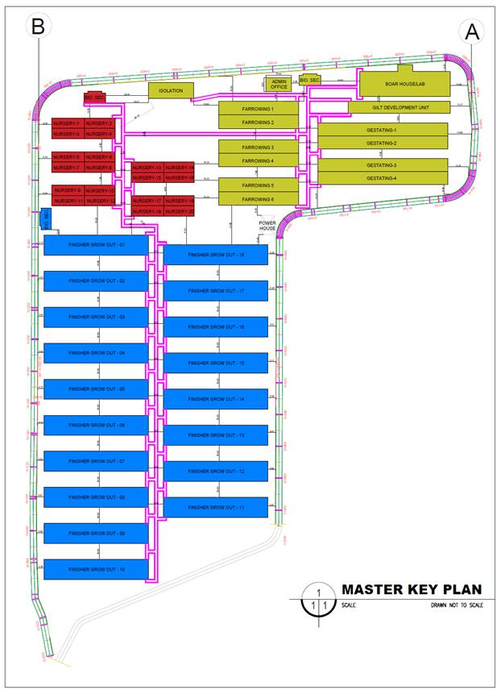
Case 3: 1000 SL Farrow to Finish Farm
Biosecurity Plan (Incorporated in the Plan)
Biosecurity Zoning
Animal Movement
Entry of People
Entry of Supplies
Entry of Feeds and Feeding Management
Exit for Mortalities
Disposal of Mortalities
Flood Control
Pest Control

Slide 29
Lessons Learned

Slide 30
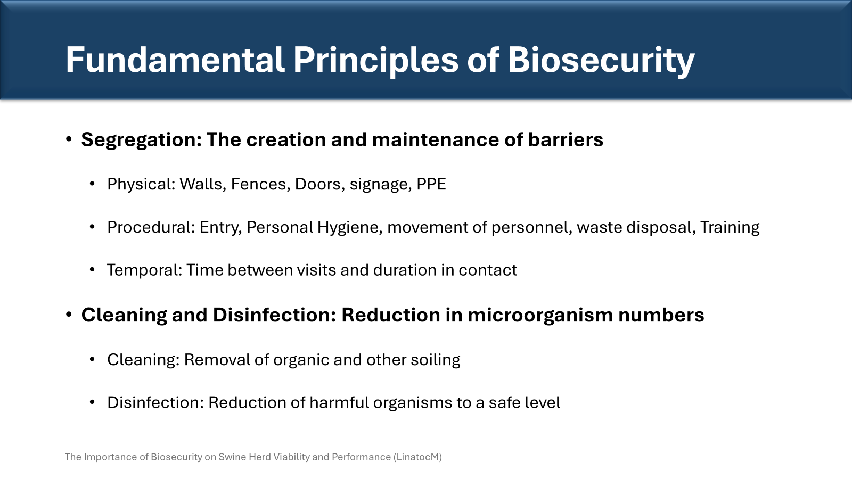
Lessons Learned # 1
Incomplete Understanding on the Fundamental Principles of Biosecurity

Slide 31
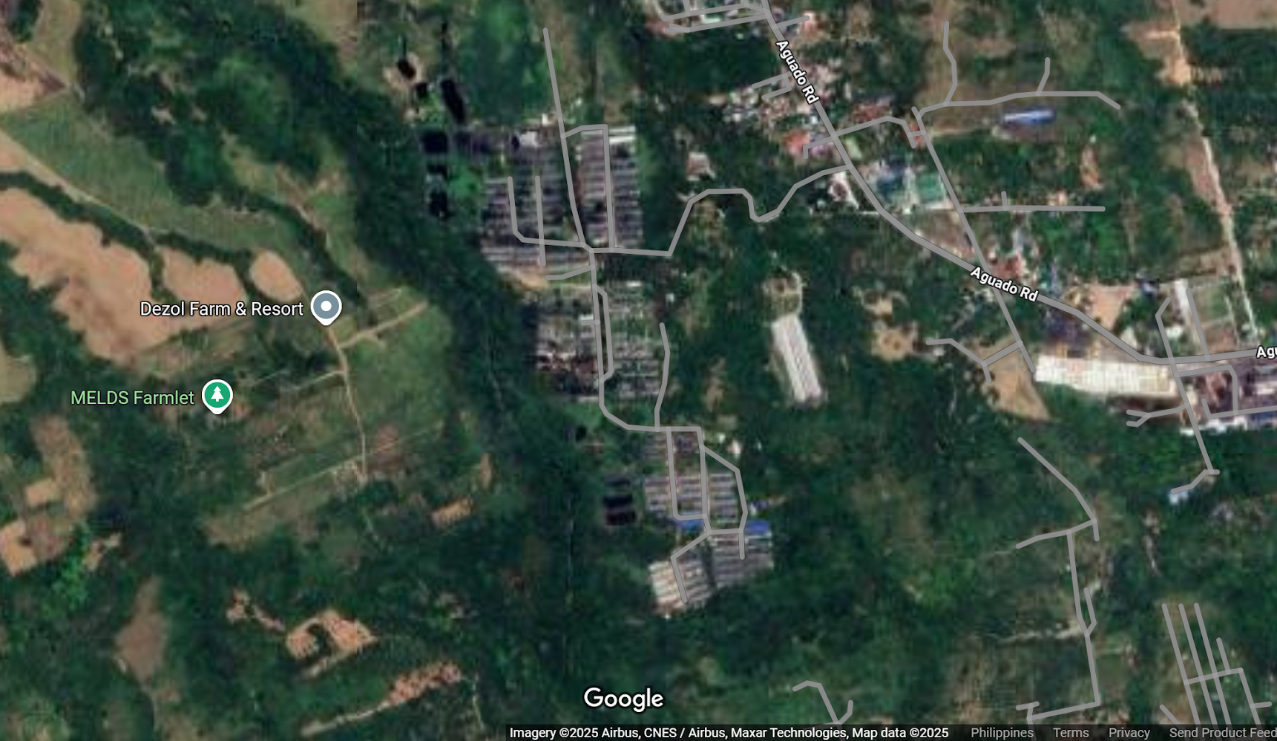
Lessons Learned # 2
Location, Location, Location!
Topography
Flow of rainwater and floods
Distance to community

Slide 32
Lessons Learned # 3
When conducting biosecurity audits, filling out the form and the scores should be the last.
Walkthrough each step of the farm’s biosecurity plan for people, supplies, feeds, vehicles coming into the farm.

Slide 33
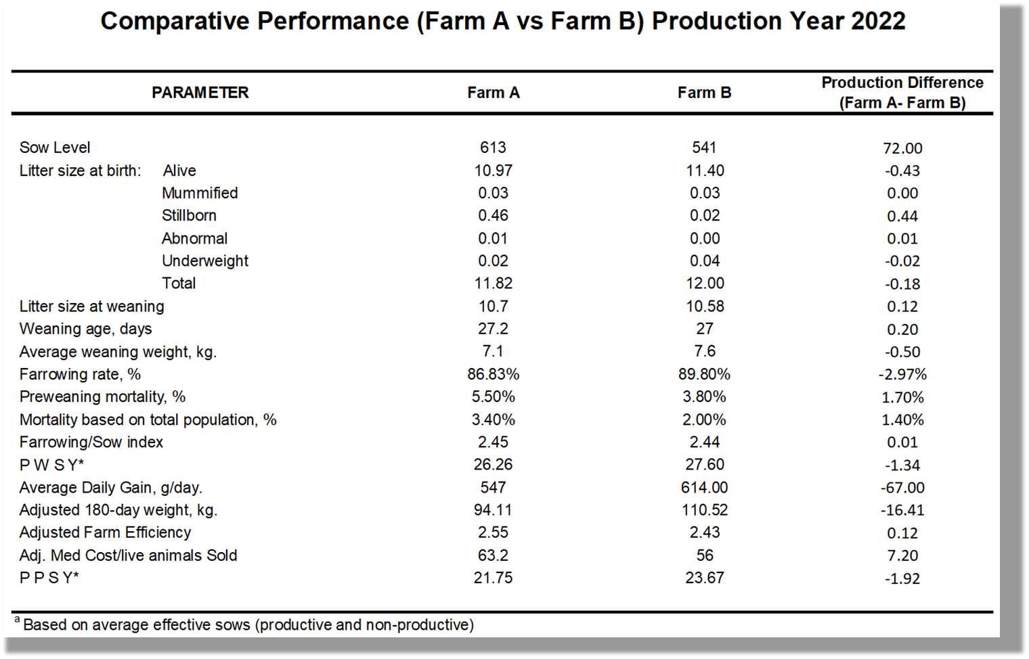
Lessons Learned # 4
Swine Farming is a business. Any inputs (Biosecurity Infrastructure) must produce improvements in the profitability of the farm.

Slide 34
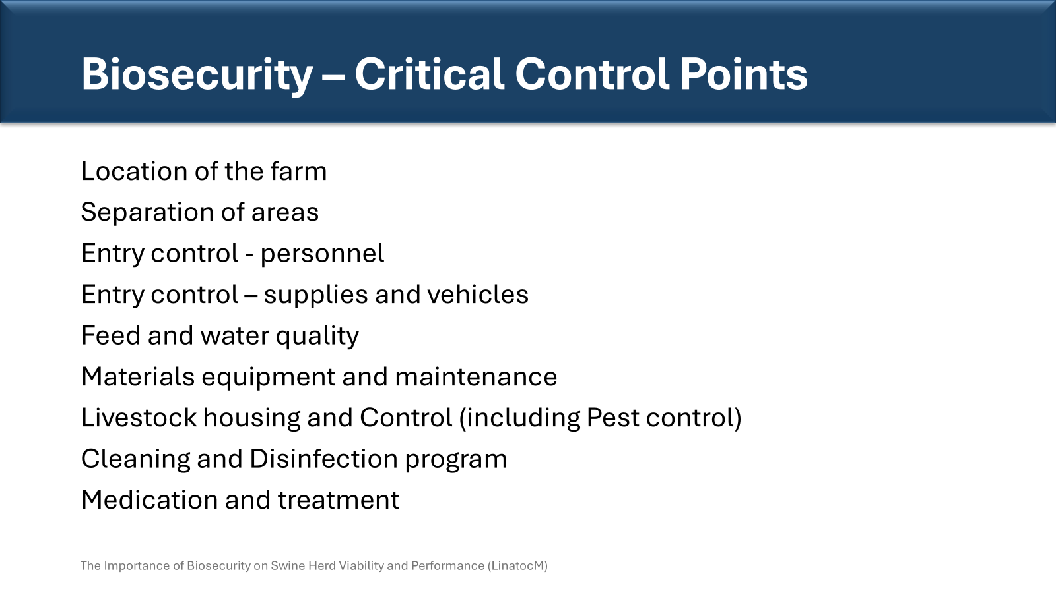
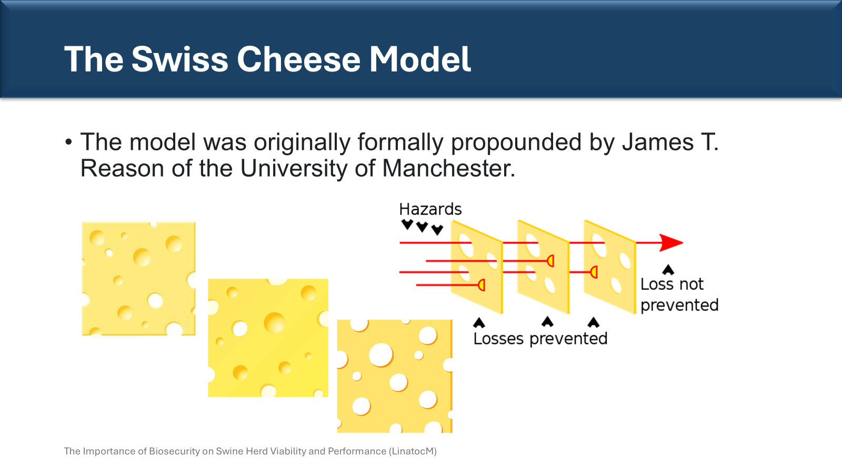
Lessons Learned # 5
For every Critical Control Point identified, there should be several approaches lined up to minimize the risk

Slide 35
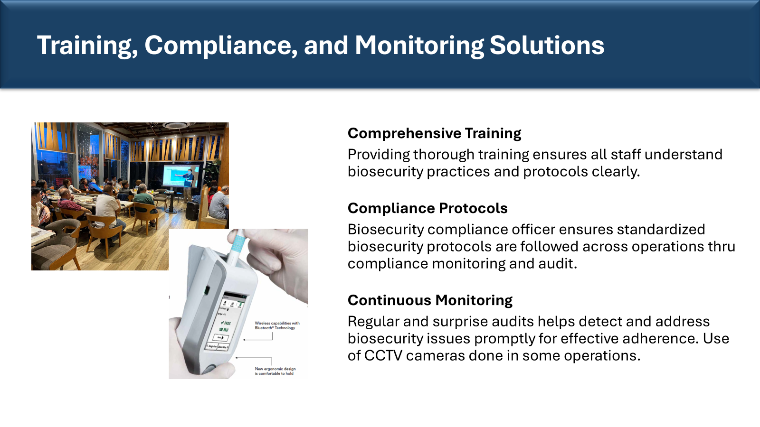
Lessons Learned # 6
Biosecurity should not only be an initiative in the farm but should be part of the CULTURE of the farm.

Slide 36
Lessons Learned # 7
Biosecurity improvements should be part of the continuous improvement process of each farm
Tiny details may need improvements
New technologies may come up that will achieve the objective at significantly less cost

Slide 37
Lessons Learned # Summary
Address incomplete understanding (fundamental principles of biosecurity)
Location is important to include topography, etc
During audits, walkthrough with people in charge how they are doing things
Swine Farming is a business. Any biosecurity infrastructure recommended entails additional capital.
For every CCP identified, there should be several approaches lined up to minimize the risk
Biosecurity should not only be an initiative in the farm but should be part of the CULTURE of the farm.
Biosecurity improvements should be part of the continuous improvement process of each farm.

Slide 38
Conclusion

Slide 39
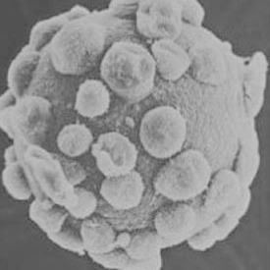
Tools in Herd Health Management
Production Records
Pig Flow
Diagnostics
Husbandry
Management
Vaccination
Biosecurity
Environment
Replacements
Medication

Slide 40


